Slide 1

Mid-progress Presentation
- 2D Manipulator -
DooHyun Lee
School of Mechanical Engineering
Yonsei University

Slide 2
Contents
Code analysis
Considering state & action space
Compare Agent Models
Parameter Tuning
To do list

Slide 3

Code Analysis
Manipulator_2d.py
Transformation
To calculate the position through the data from observation space
Translation, rotation
$$\left[\begin{matrix}cosθ & −sinθ & x′ \\ sinθ & cosθ & y′ \\ 0 & 0 & 1\end{matrix}\right]$$

Slide 4
Code Analysis
Manipulator_2d.py
Manipulator2D(env)
5x5 size space
action → robot’s translation, robot’s rotation, joint1’s rotation, joint2’s rotation
Reward
tol > l → +1
Out of boundary → -100
Don’t reach to goal → -l² (each timestep)
Step
Calculate robot arm’s kinematics by obtained action
Reset
Reset variables when episode starts

Slide 5
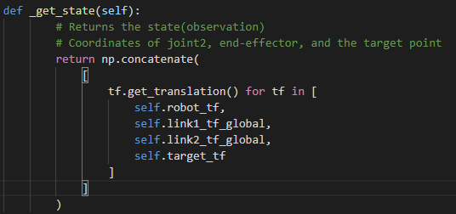
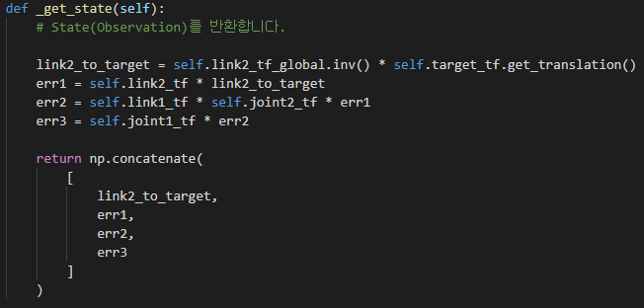
Considering State, Action
State
Original state : each points’ position (robot, link1, link2, target)
This method shows a bad performance(low number of success times)
Tried state : using position error as state
Better performance than original one

Slide 6

Considering State, Action
Action
Original Action space
-π < robot, joint1, joint2 < π
Tried Action space
Half (robot, joint1)
-π < joint2 < π
-$\frac{\text{π}}{2}$ < robot, joint1< $\frac{\text{π}}{2}$
Double (robot, joint1)
-π < joint2 < π
-2π < robot, joint1< 2π

Slide 7
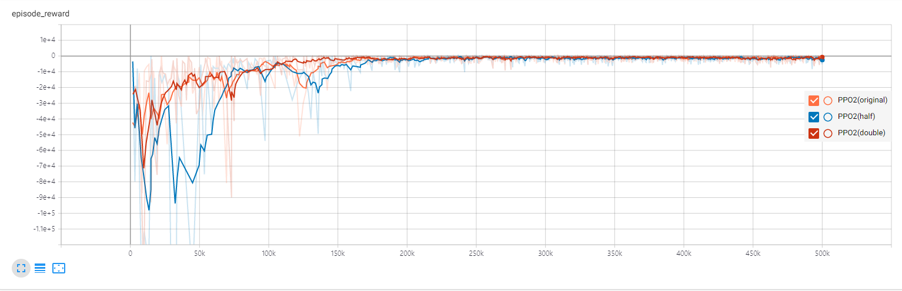
Considering State, Action
Result
Double method has best convergence time & success counts during training
→ Choose ( -2π < robot, joint1< 2π, -π < joint2 < π ) action space

Slide 8
Compare agent models
Action, Observation space → Box
A : Action space
O : Observation space
→ Compare A2C, ACKTR, DDPG, PPO2, SAC agent models
 | A2C |  | ACER |  | ACKTR |  | DDPG |  | DQN |  | GAIL |  | PPO1 |  | PPO2 |  | SAC |  | TD3 |  | TRPO
 | A | O | A | O | A | O | A | O | A | O | A | O | A | O | A | O | A | O | A | O | A | O
Discrete
Box
MultiDiscrete
Multibinary

Slide 9
Compare agent models
In same condition
Timesteps : 700,000 steps
Gamma : 0.9
 | A2C | SAC | DDPG | PPO2 | ACKTR
Episode len_mean | 320 | 1450 | 4000 | 290 | 312
Success counts | 1165 | 289 | 122 | 1587 | 1224
Out of boundary | 276 | 48 | 33 | 107 | 163
Time for training | 13m 41s | 47m 2s | 32m 31s | 12m 23s | 12m 25s
(Original action space)

Slide 10
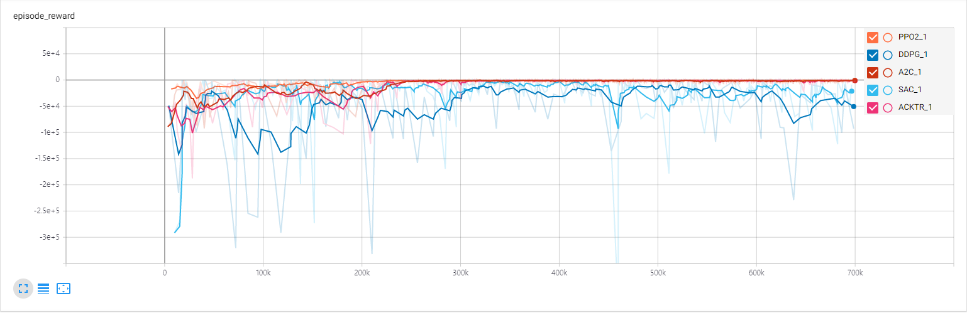
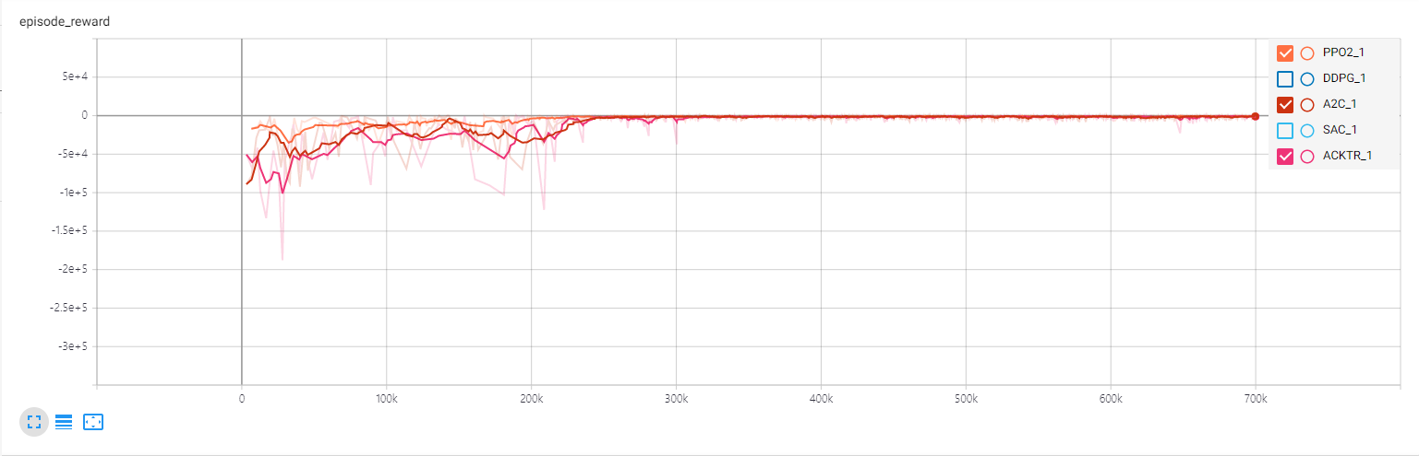
Compare agent models
Result graph
Convergence time : PPO2 > A2C > ACKTR > SAC > DDPG
→ PPO2 shows best numerical values for the most part including convergence time

Slide 11
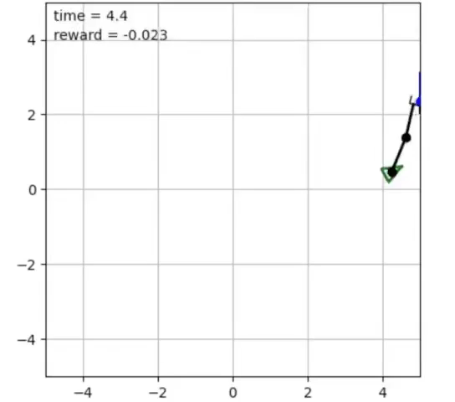
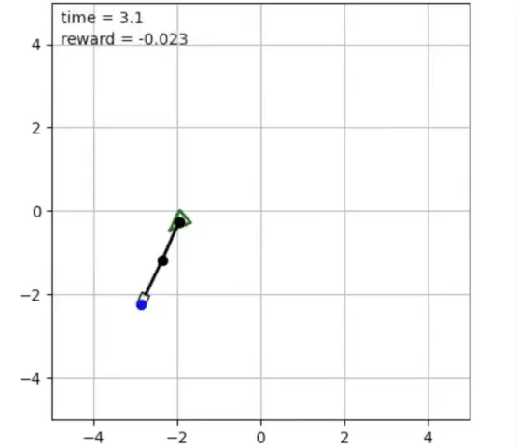
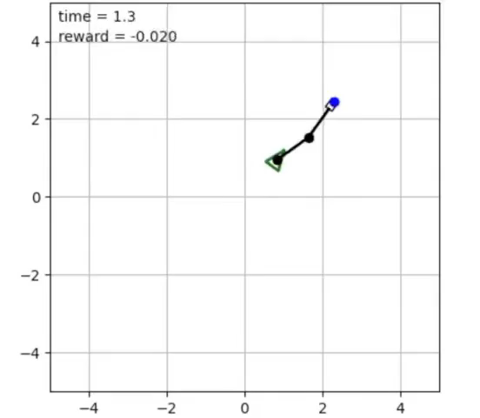
Compare agent models
A2C ACTKR PPO2
DDPG and SAC show low performance (take long time to success or out of boundary)
(Original action space)

Slide 12
Parameter Tuning
Learning rate (gamma = 0.9)
→ Learning rate = 2.5e-4 model shows overall good figures
 | lr = 0.001 | lr = 2.5e-4 | lr = 1e-4
Episode len_mean | 601 | 230 | 275
Success counts | 332 | 2049 | 1535
Out of boundary | 39 | 69 | 107
Time for training | 12m 11s | 11m 52s | 12m 14s

Slide 13
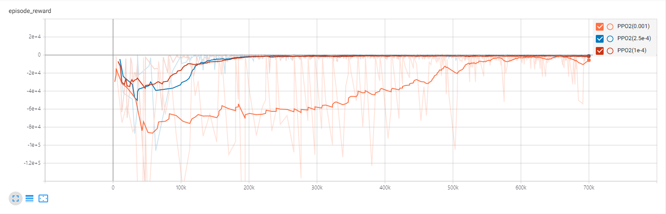
Parameter Tuning
Learning rate (gamma = 0.9)
There is little difference in convergence time between lr = 2.5e-4 and lr = 1e-4
Choose lr = 2.5e-4

Slide 14
Parameter Tuning
Gamma(lr = 2.5e-4)
 | Gamma = 0.99 | Gamma = 0.9 | Gamma = 0.5
Episode len_mean | 1300 | 230 | 260
Success counts | 224 | 2049 | 1713
Out of boundary | 88 | 69 | 241
Time for training | 12m 7s | 11m 52s | 12m 19s

Slide 15
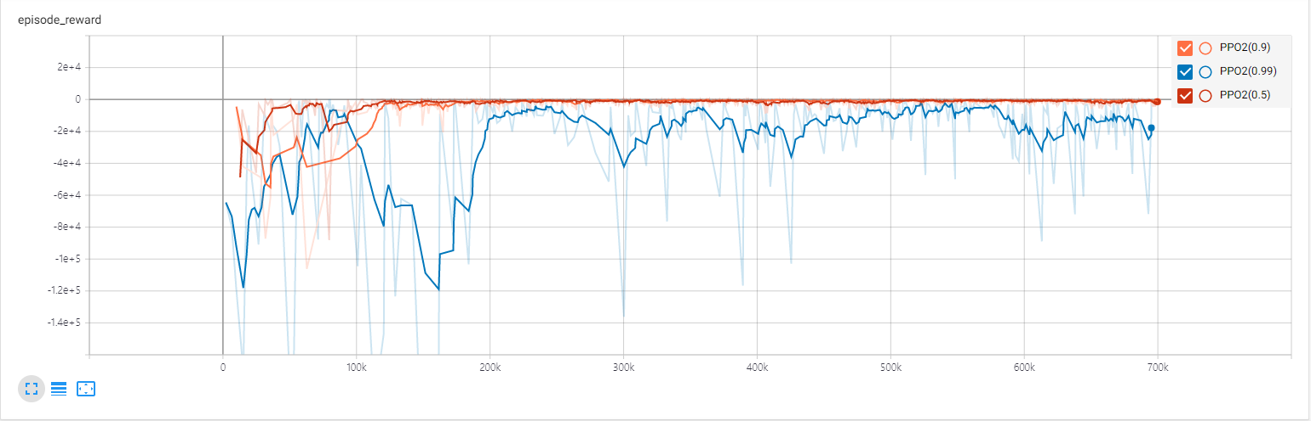
Parameter Tuning
Gamma(lr = 0.0001)
Gamma = 0.5 and gamma = 0.9 show similar convergence time but model with gamma of 0.5 often shows out of boundary case.
→ Choose gamma = 0.9

Slide 16
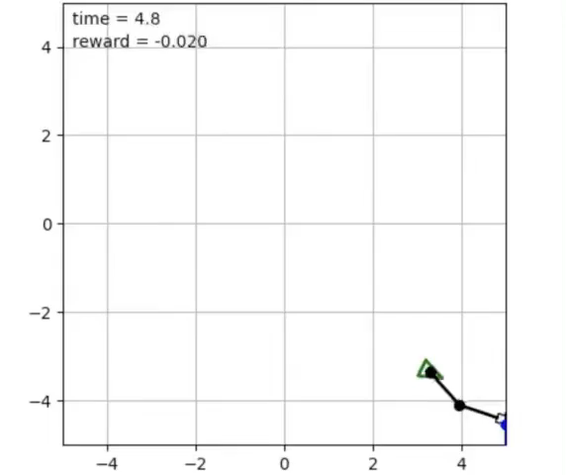
Mid progress - result
PPO2 agent model
Timesteps = 700,000
Learning rate = 2.5e-4
Gamma = 0.9

Slide 17
To do list
Agent model studying for theoretical verification
Learning rate decaying
Try another state, action space
Reward engineering

Slide 18
THANK YOU FOR LISTENING

